Slide 1
Paid Leave in 2020 Elections
Student’s Name
Institution
Notes:
[Notes to trainer:
Before you begin, Communicator 2007 should already be installed and configured on your computer.
You should have functioning computer speakers and a microphone.
You need to sign in to Communicator 2007.
You should be familiar with the instant messaging (IM) and presence capabilities of Communicator 2007 as presented in the online training presentation titled, “Introduction to Office Communicator 2007.”
For detailed help in customizing this template, see the very last slide. Also, look for additional lesson text in the notes pane of some slides.]

Slide 2
Contents
Overview: Insight on labor movement
2020 Elections: Candidates
2020 Elections: Candidates proposals on paid leave
Effects of policies: Employees
Paid leave: Opinion of Americans
Current Legislations
State Action: States’ laws

Slide 3


Overview: Insight on Labor Movement
Labor movement protects workers
Organized labor unions fight for the interest of workers
They are also influenced by political process and climate
Policy changes impact the labor movement and actions
Labor movement started in the 1700s
Notes:
Labor movement, in the United States, started in the 1700s and has since transformed due to the changing working environment. The political process is one of the factors that affect the labor movement actions. Labor movement, through the labor unions, advocate and protect the rights and interests of their members (workers). Even though they are independent institutions, they are largely influenced by the political processes. Policy changes largely affect their operations and actions.

Slide 4
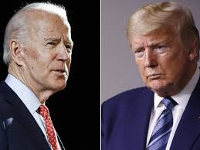
2020 Elections: Candidates
2020 presidential Elections is made up of two main candidates:
Donald Trump of Republican Party
Joe Biden- Democratic presidential Nominee
Each candidate is aiming to win the elections
The current trajectory shows Biden has the lead
Trump’s challenge is policy and response to Covid-19
Democrats are taking the opportunity
Notes:
The 2020 Presidential elections in the United is significant and will be a historical event as the two main candidates (President Donald Trump and Joe Biden) battle for the White House. The current poll trajectory is showing that Joe Biden is leading in most state. With more than 75 million people already casted early votes, the Democrats are optimistic about winning the elections. However, the challenge for the president’s side has been the way his administration is handling the economic and social aspects of Coronavirus pandemic. The Democrats have been taking their campaign on the basis that the current administration has failed to protect American people, their jobs, and businesses.

Slide 5
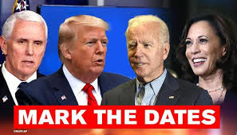
2020 elections: Candidates’ Proposals
President Trump
Proposes 12-week paid leave
Claimed he has already signed the policy
Families First Coronavirus Response Act
Joe Biden
President’s Trump has failed to protect American jobs and business
Proposes a 12-week paid leave for all workers for their own or when a family member is ill
Notes:
As the Coronavirus pandemic continue to ravage the country, the impacts are felt greatly by those who are out of jobs either because they have been laid off or they are sick or someone close to them needs their attention more. Politicians, on the other hand, continue to pledge different promises that they believe will help millions of Americans whose jobs are no longer there or their businesses are feeling the heat of coronavirus. Both candidates, Trump and Biden, have pledged their support for a 12-week annual leave for all employees when they are sick or someone close to them is seriously ill.

Slide 6


Effects of Policy
Employees
For employees, this will be a win
Employees will enjoy more benefits with job security
The current law do not support paid leave
Employers
For employers, this will be a big blow to their profitability
They will have to pay workers even when they are out of work
Notes:
Most workers will agree that the changes proposed by each candidate will definitely have a positive impact on them and their families. A 12-week paid leave is beneficial to workers. They will no longer have to worry about taking care of their health (for those who are sick) and their loved ones (who are seriously ill and may need their attention) because of job insecurity. However, for employers, it will not a smooth run as usual because they will have to prepare to incur the cost of paying workers who are on leave for 12-week period in a year. This, for some businesses, will mean increasing their operations cost and reducing profitability if they don’t change strategy to make up for the differences.

Slide 7
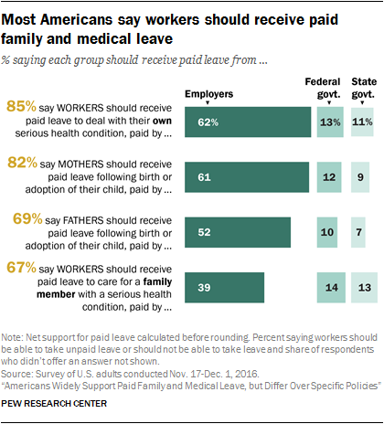
Paid Leave: Opinions of Americans
Pew Research Center
More Americans want paid leave
85% say all workers should receive paid leave
82% support mothers taking paid leave
69% support fathers taking paid leave
Most employers also support employees to take leave
The controversy emerges in whether organizations can pay (Smith, 2020)
Notes:
It is clear that the issue of paid leave is becoming a polarizing debate as people are divided on whether it is practically possible to implement. Politicians make proposals, but some of them, as everyone knows, as just for political reasons. On the issue of paid leave, it is possible to achieve, but it requires collaboration between the policymakers and implementers who are the employers. Without the support of employers, it would not be possible. Therefore, as much as the candidates would want to convince the people that they want the best for the employees, they need to secure the support of employers.

Slide 8
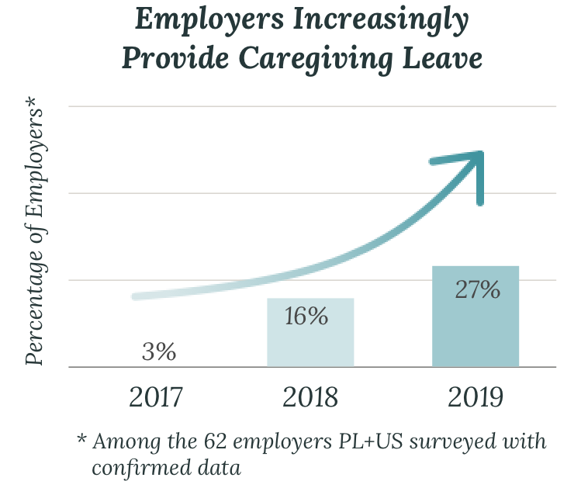
Paid Leave in America
Even though there are no laws on paid leave
Employers are supporting the idea
To support their workers who are in problems
In 2017, 3% of employers were giving paid leave
In 2019, it increase to 27%
The trajectory has been increasing over the past 3 years
More employers are showing their support for employees’ paid leave
This means that it is possible to realize
The trajectory is expected to go up in the coming years
Notes:
Employers who realize the important role that their employees play in their organizations appreciate them by supporting them when they are in problems. The above graphical representation shows that over the last three years, employers have been showing concern for their employees by offering them paid leave. In 2017, only 3% of employers were offering their employers caregiving leave. In 2018, the number increased to 16% and in 2019, there were 27% of the employers offering their employees with caregiving leave (Pew Research Center).

Slide 9

Current Legislations
Currently, there is Family and Medical Leave Act
It does not involve paid leave for employees
It requires big organizations with large workforce to provide 12-week annual unpaid leave (Panoma, 2019)
Recently, President Trump signed into law FFCRA
Families First Coronavirus Response Act (FFCRA) of 2020
Targeted the private employers
They are set to lose more with the new policy
Notes:
Even though there is a law, the Family and Medical Leave Act in place, it has no provision that provides for paid leave for employees. As such, the presidential candidates are aiming at changing it and providing a section that provide paid leave. This will be a big boost for the labor movement in the United States, but a big blow to the private employers who have been ripping off benefits from their employees. Despite that the coronavirus effects have already hit them, the newly signed law, FFCRA is set to impact the private employers negatively.

Slide 10
State Action
Paid leave is not a new thing to states
Some states have laws on paid leave
However, majority still lack the law
This has changed the composition of workforce (Brainerd, 2017)
Most states still rely on the FMLA of 1993
Concerns continue to emerge on economic repercussions
Potential increase in costs to employers
States with paid leave include:
New York-which took effect in 2018
Rhode Island
Washington, D.C-took effect in 2020
Paid leaves in these three states provide job protection that exceeds the provisions of FMLA (Brainerd, 2017)
Other states include:
New Jersey
California
They target employees from large institutions
Notes:
It is clear that some states have already gone ahead to provide their employees with paid leave. However, they are also different because some states like California and New Jersey’s policies on paid leave targets only employees from the large institutions. This means that employees from small firms are not protected as per say because the law is concentrating on the large institutions.

Slide 11
References
Brainerd, J. (2017). Paid Family Leave in the States. National Conference of State Legislatures, 25(31), 1.
Panoma. (2019 October). The Business Impacts of Paid Leave. American Sustainable Business Council (Online). https://assets.ctfassets.net/n0merlwkrasg/59MwRB7HNlFRL7VMYqYMGj/4486aa4327ac0a502ff5d67dc0d52863/Business-impacts-of-paid-leave-A-Panorama-report.pdf
Smith, A. (2020, September 8). Presidential Election: Candidates back paid-leave proposals. SHRM (Online). https://www.shrm.org/resourcesandtools/legal-and-compliance/employment-law/pages/presidential-election-2020-paid-leave.aspx

